Slide 1





Demystifying Concept Mapping: Applications in Teaching Introductory Biology and Anatomy and Physiology
Peter J. Park and K. Emma Emanuel
ViABLE – Association for Biology Laboratory Education
6-24-2021

Slide 2
Mentimeter Break

Slide 3
Outline
What is Concept Mapping?
What is a Concept Map?
Literature Review
Pros and Cons of Concept Maps
Classroom Implementation of Concept Maps
Introduction to CMAPS software
Case Studies in Introductory Biology
Case Studies in Anatomy and Physiology

Slide 4
Outline
What is Concept Mapping?
What is a Concept Map?
Literature Review
Pros and Cons of Concept Maps
Classroom Implementation of Concept Maps
Introduction to CMAPS software
Case Studies in Introductory Biology
Case Studies in Anatomy and Physiology

Slide 5
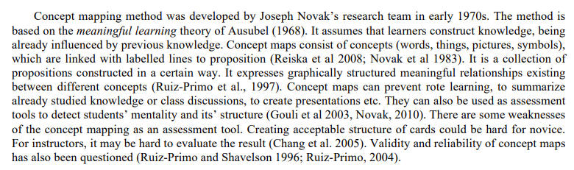
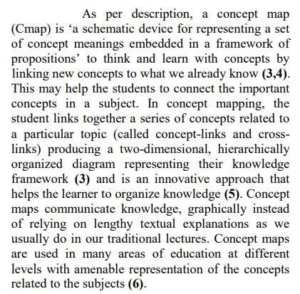
What is a Concept Mapping?
(Soika et al. 2012)
(Sivaraman 2020)

Slide 6
Outline
What is Concept Mapping?
What is a Concept Map?
Literature Review
Pros and Cons of Concept Maps
Classroom Implementation of Concept Maps
Case Studies in Introductory Biology
Case Studies in Anatomy and Physiology

Slide 7
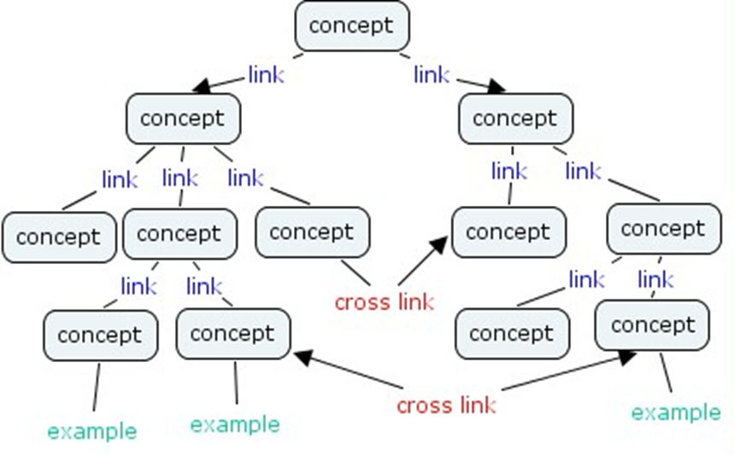
What is a concept map?
Synonyms: flow chart, knowledge web, (mind map?)
Hierarchical
Influenced by previous knowledge
Visual way of communicating knowledge
Components of a Concept Map: concepts, links, cross-links
(Source: Hu 2006)

Slide 8
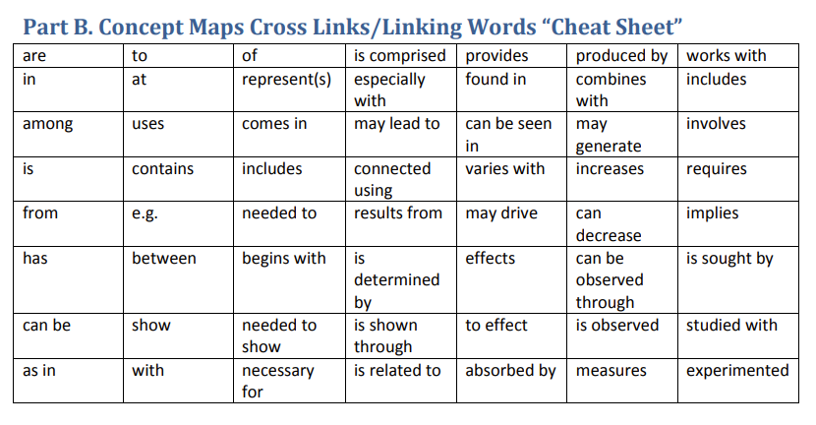
“Link”- word(s) that connect concept-to-concept
(Source: nhsd.org)

Slide 9
Outline
What is Concept Mapping?
What is a Concept Map?
Literature Review
Pros and Cons of Concept Maps
Classroom Implementation of Concept Maps
Introduction to CMAPS software
Case Studies in Introductory Biology
Case Studies in Anatomy and Physiology

Slide 10


Sivaraman (2020)
Goal of Study: Tested the effectiveness of concept mapping in an undergraduate biochemistry course (lipid chemistry and metabolism). → CONTENT MASTERY
Results:
  - For content assessment, treatment group outperformed controls.
  - For attitudes assessment, overwhelming majority (87%) of students (treatment and control combined) expressed that concept mapping helped them understand the lecture content.
Zadeh et al. (2015)
Goal of Study: Explored the effectiveness of concept mapping in the learning of nursing skills (e.g., cleaning, injection, and sterilizing). → SKILLS MASTERY
Results:
- Mean scores of the treatment group were higher than those
of the control group.

Slide 11
Outline
What is Concept Mapping?
What is a Concept Map?
Literature Review
Pros and Cons of Concept Maps
Classroom Implementation of Concept Maps
Introduction to CMAPS software
Case Studies in Introductory Biology
Case Studies in Anatomy and Physiology

Slide 12
Pros/Cons of Concept Maps
PROS
Elicits prior knowledge
Encourages high-level Bloom’s learning (analysis, synthesis)
Integrative across topics
Adaptive, flexible
Many right versions (NOTE: Some can be wrong!)
Visual, diagrammatic
Minimizes rote learning (e.g., memorization, flash cards, outlines)
Supplements and enhances existing learning habits
Quick evaluation tool of student mastery
CONS
Requires prior knowledge
Encourages high-level Bloom’s learning
Difficult to grade! (NOT rubric-friendly)
May take time for students to master (students may be frustrated initially)
In-class map building activity can be time-intensive
Not always applicable to all subjects
Some maps make sense only to the map’s author

Slide 13
Outline
What is Concept Mapping?
What is a Concept Map?
Literature Review
Pros and Cons of Concept Maps
Classroom Implementation of Concept Maps
Introduction to CMAPS software
Case Studies in Introductory Biology
Case Studies in Anatomy and Physiology

Slide 14
How do you use concept maps?
Method 1: “Modeling” - Teach students how to build concept maps using a simple example, then encourage students to build their own for course content/studying purposes.
Method 2: Provide students pre-made concept maps (Today is your lucky day!)
Method 3: Provide students incomplete concept maps that have be completed by students
Method 4: Showcase building a concept map during lecture (all while encouraging real-time feedback!) and then as a “gift,” provide the map to the class!
Method 5: Concept maps can be used for formative assessment (graded or ungraded) and summative assessment.

Slide 15
Suggestions for Getting Comfortable with Concept Maps
Read other people’s concept maps!
Have patience. Novice concept map learners may take time to master this technique.
Start simple. Consider using a non-biology example to teach concept map building techniques.
Keep it simple. If you plan to use many concept maps in a course, try to be consistent in the links and umbrella terms.
Concept maps are often read left-to-right and top-to-bottom.
Color code concept bubbles!
Couple concept maps with other resources.
Don’t be afraid to be creative.

Slide 16
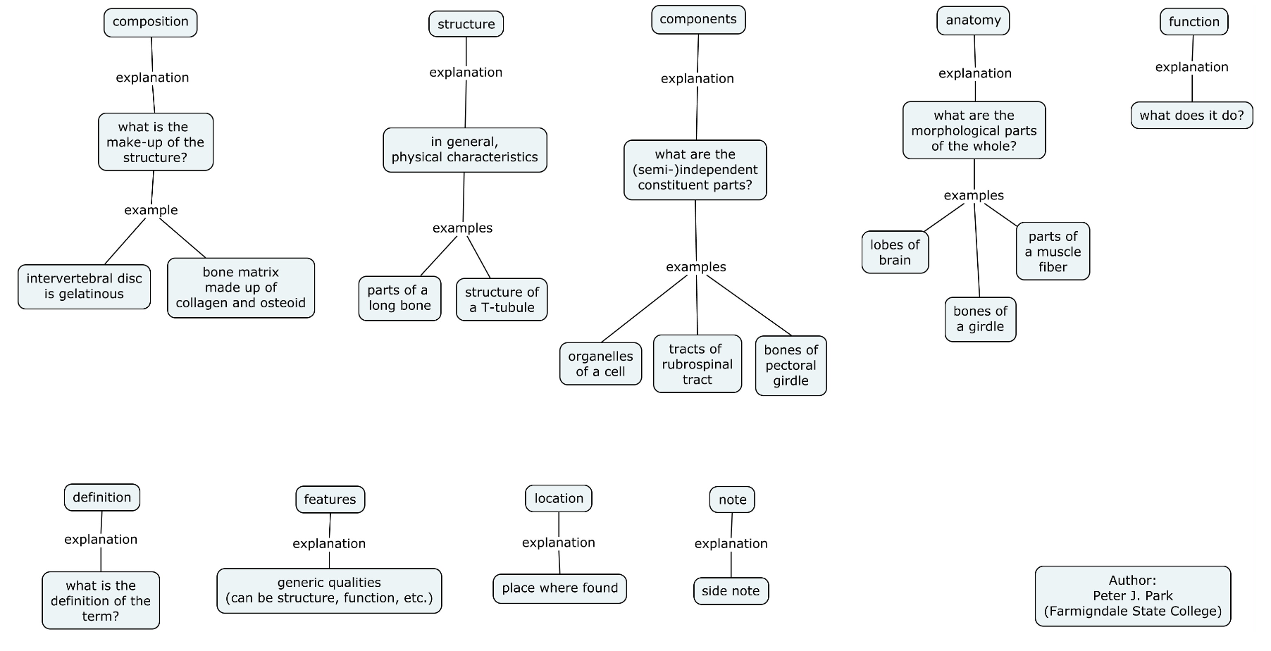
Keep it simple. If you plan to use many concept maps in a course, try to be consistent in the links and umbrella terms.
LEGEND: Anatomy and Physiology Concept Map Links

Slide 17
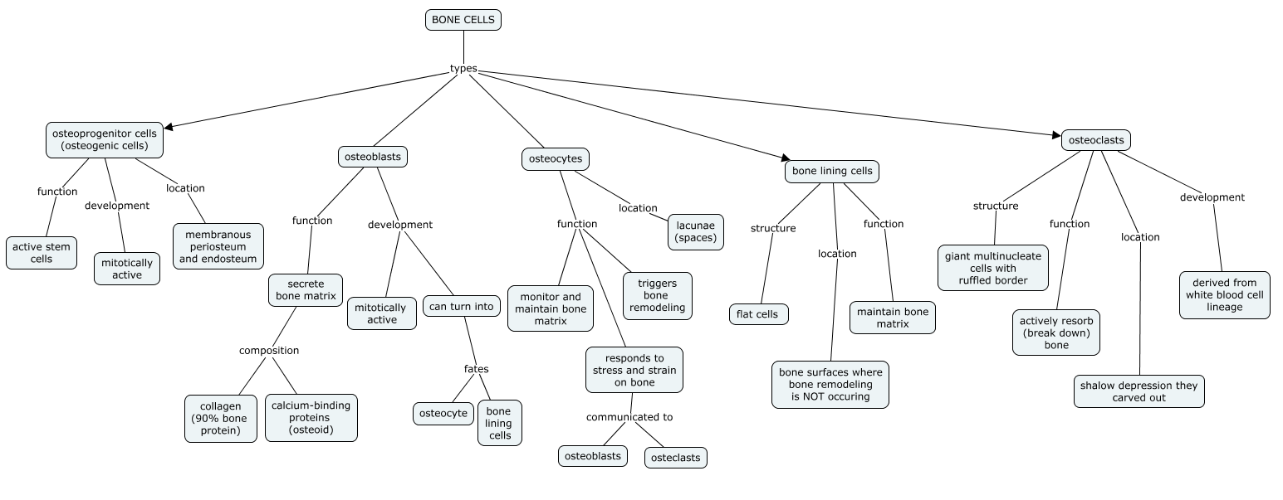

Slide 18
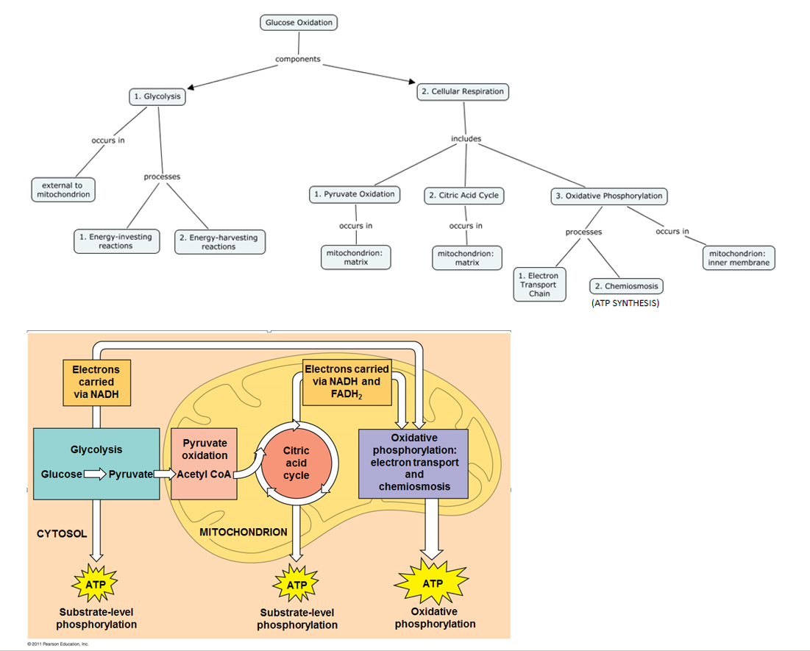
Couple concept maps with other resources.

Slide 19
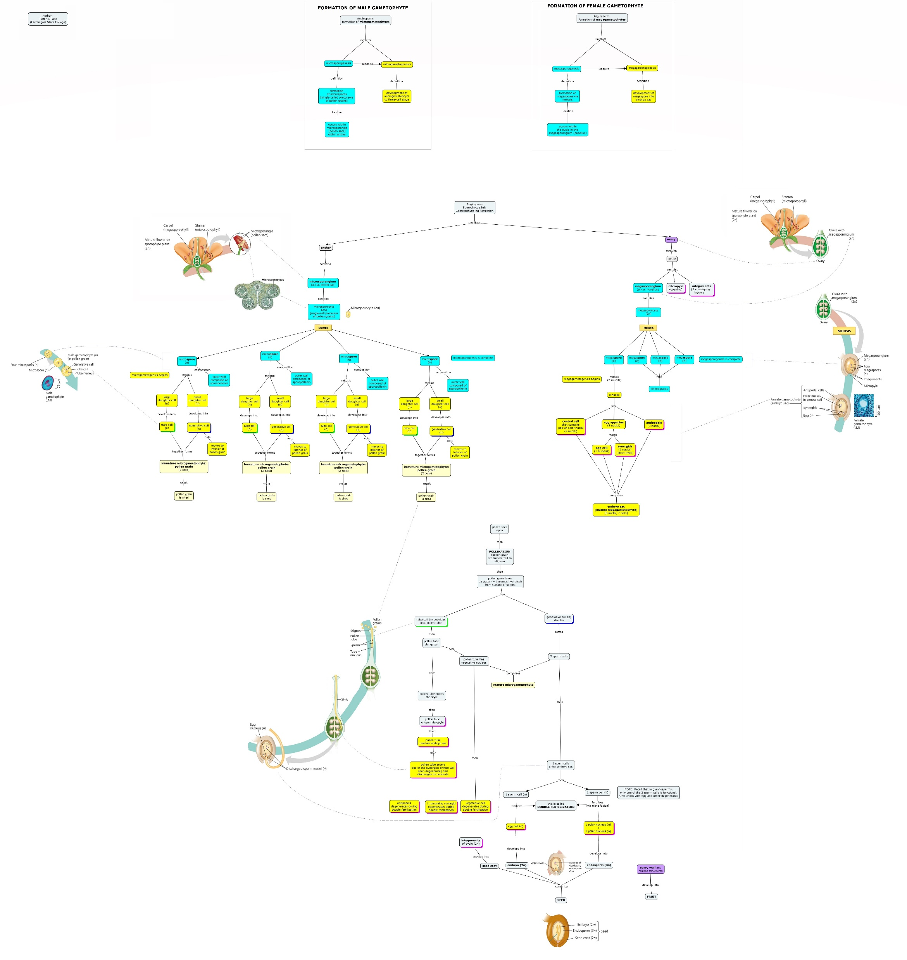
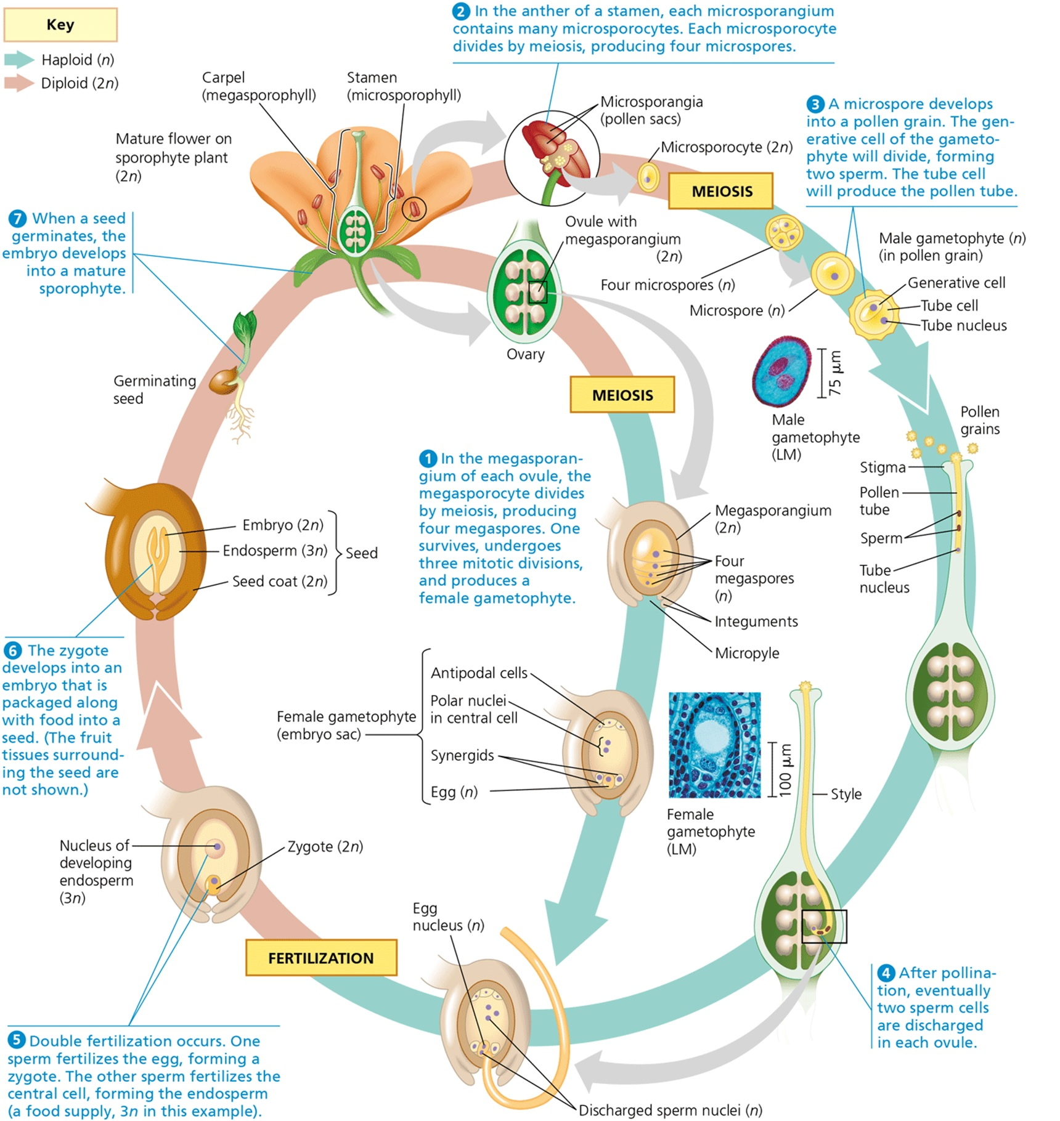
Couple concept maps with other resources.

Slide 20
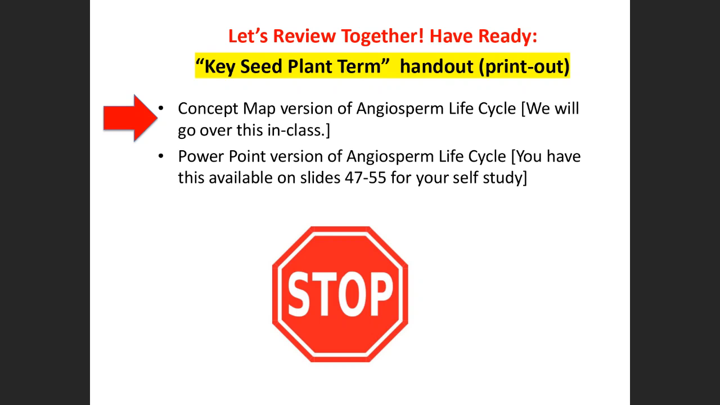
Couple concept maps with other resources.
https://youtu.be/XOPVGNnSb5Y (demo: 12:12)

Slide 21
Outline
What is Concept Mapping?
What is a Concept Map?
Literature Review
Pros and Cons of Concept Maps
Classroom Implementation of Concept Maps
Introduction to CMAPS software
Case Studies in Introductory Biology
Case Studies in Anatomy and Physiology

Slide 22
CMAPS SOFTWARE WALKTHROUGH AND EXERCISE:
What is the structure of your favorite course?

Slide 23
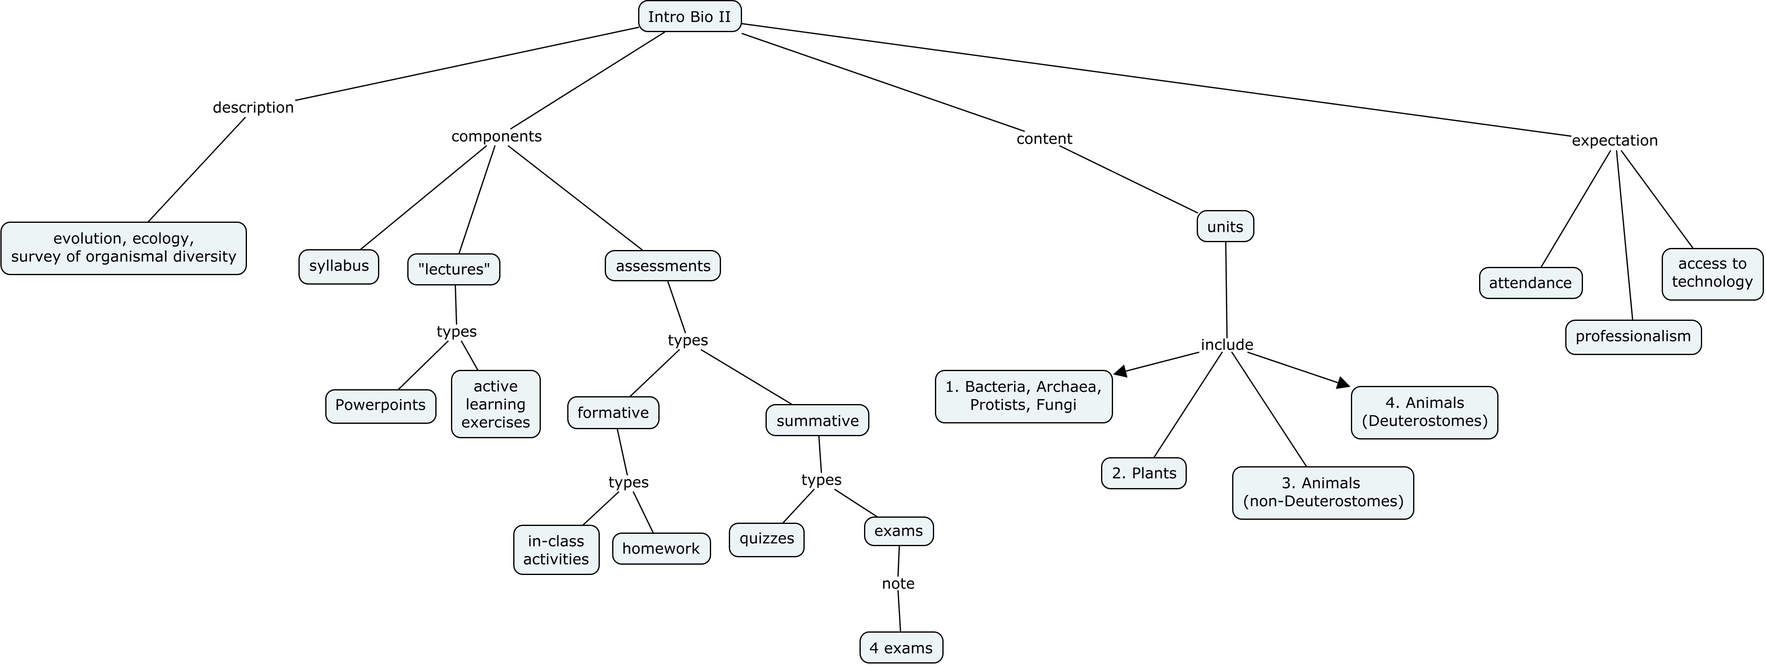

Slide 24
Outline
What is Concept Mapping?
What is a Concept Map?
Literature Review
Pros and Cons of Concept Maps
Classroom Implementation of Concept Maps
Introduction to CMAPS software
Case Studies in Introductory Biology
Case Studies in Anatomy and Physiology

Slide 25
Method 1: “Modeling” - Teach students how to build concept maps using a simple example, then encourage students to build their own for course content/studying purposes.
EXAMPLE: Place the following terms into a single concept map:
Matter
Atom
Elements
Metal
Non-metal
Neutrons
Subatomic Particles
Anion
Protons
Electrons
Mass Number
Atomic Number
Chemical Reactions
Isotope
Ion
Cation

Slide 26
Please open the file “ABLE_Method1_Demo.cmap” in CMAPS (located in Method 1 folder).

Slide 27
CMAPS DEMO

Slide 28
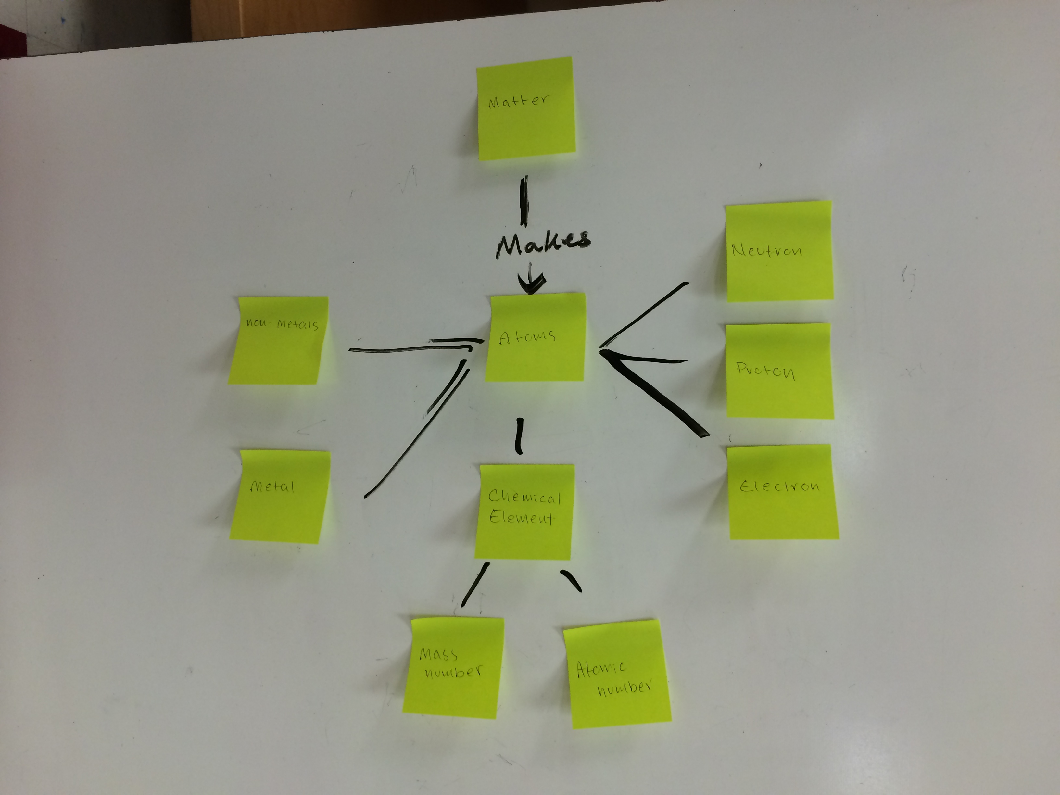
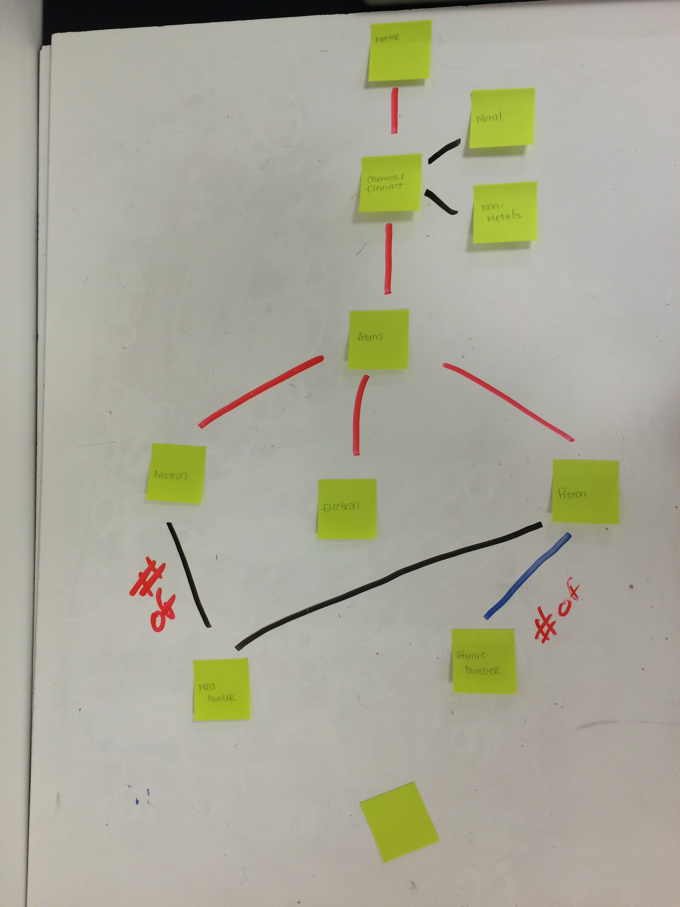
Method 1: “Modeling” – In-class implementation
Materials:
- Mini-whiteboard
- Dry-erase markers
- Post-its
Question: How do these student concept maps compare?

Slide 29
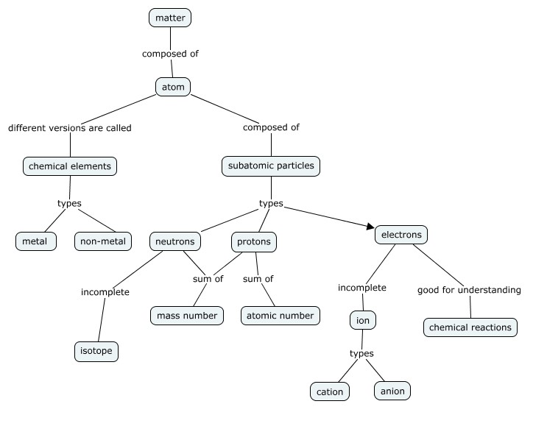
Method 1 Exercise - Key

Slide 30
Method 2

Slide 31
Method 2: Provide students pre-made concept maps (Today is your lucky day!)
Browse examples in our Dropbox folder “Method 2”

Slide 32
Mentimeter Break

Slide 33
Method 3

Slide 34
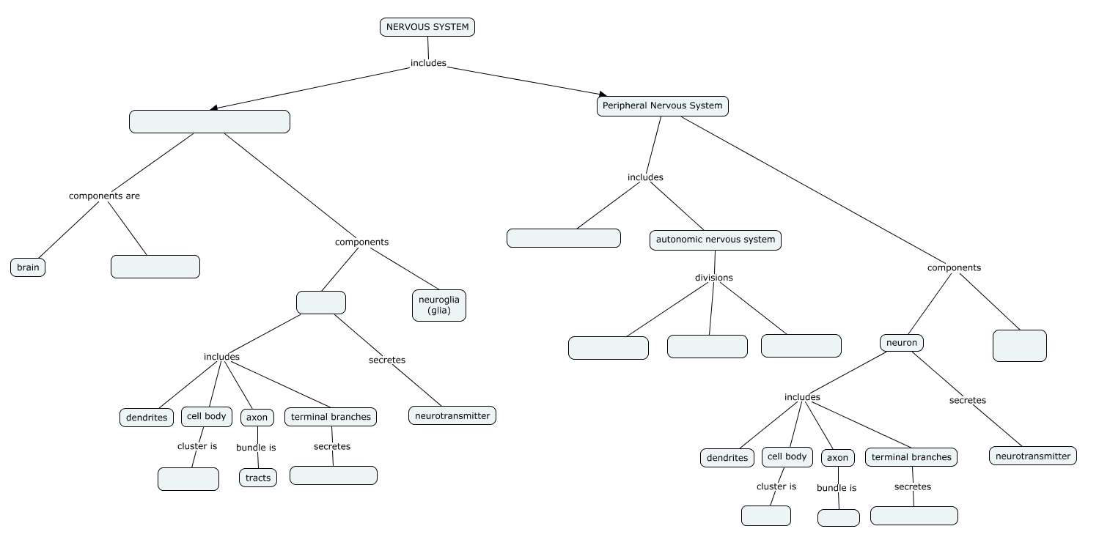
Method 3: Provide students incomplete concept maps that have be completed by students
Example 1: Nervous System

Slide 35
Please open the file “Nervous System_Fill-in_cmap.cmap” in CMAPS (located in Method 3 folder).

Slide 36
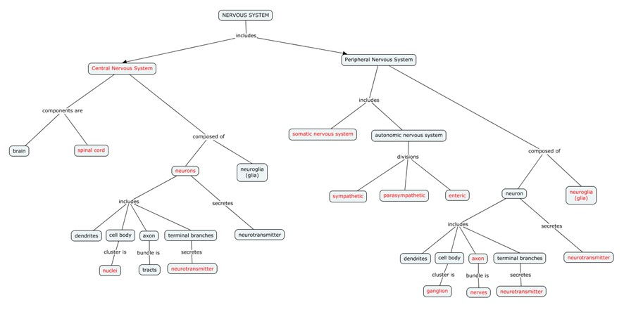
Method 3 Exercise - Key

Slide 37
Method 4

Slide 38
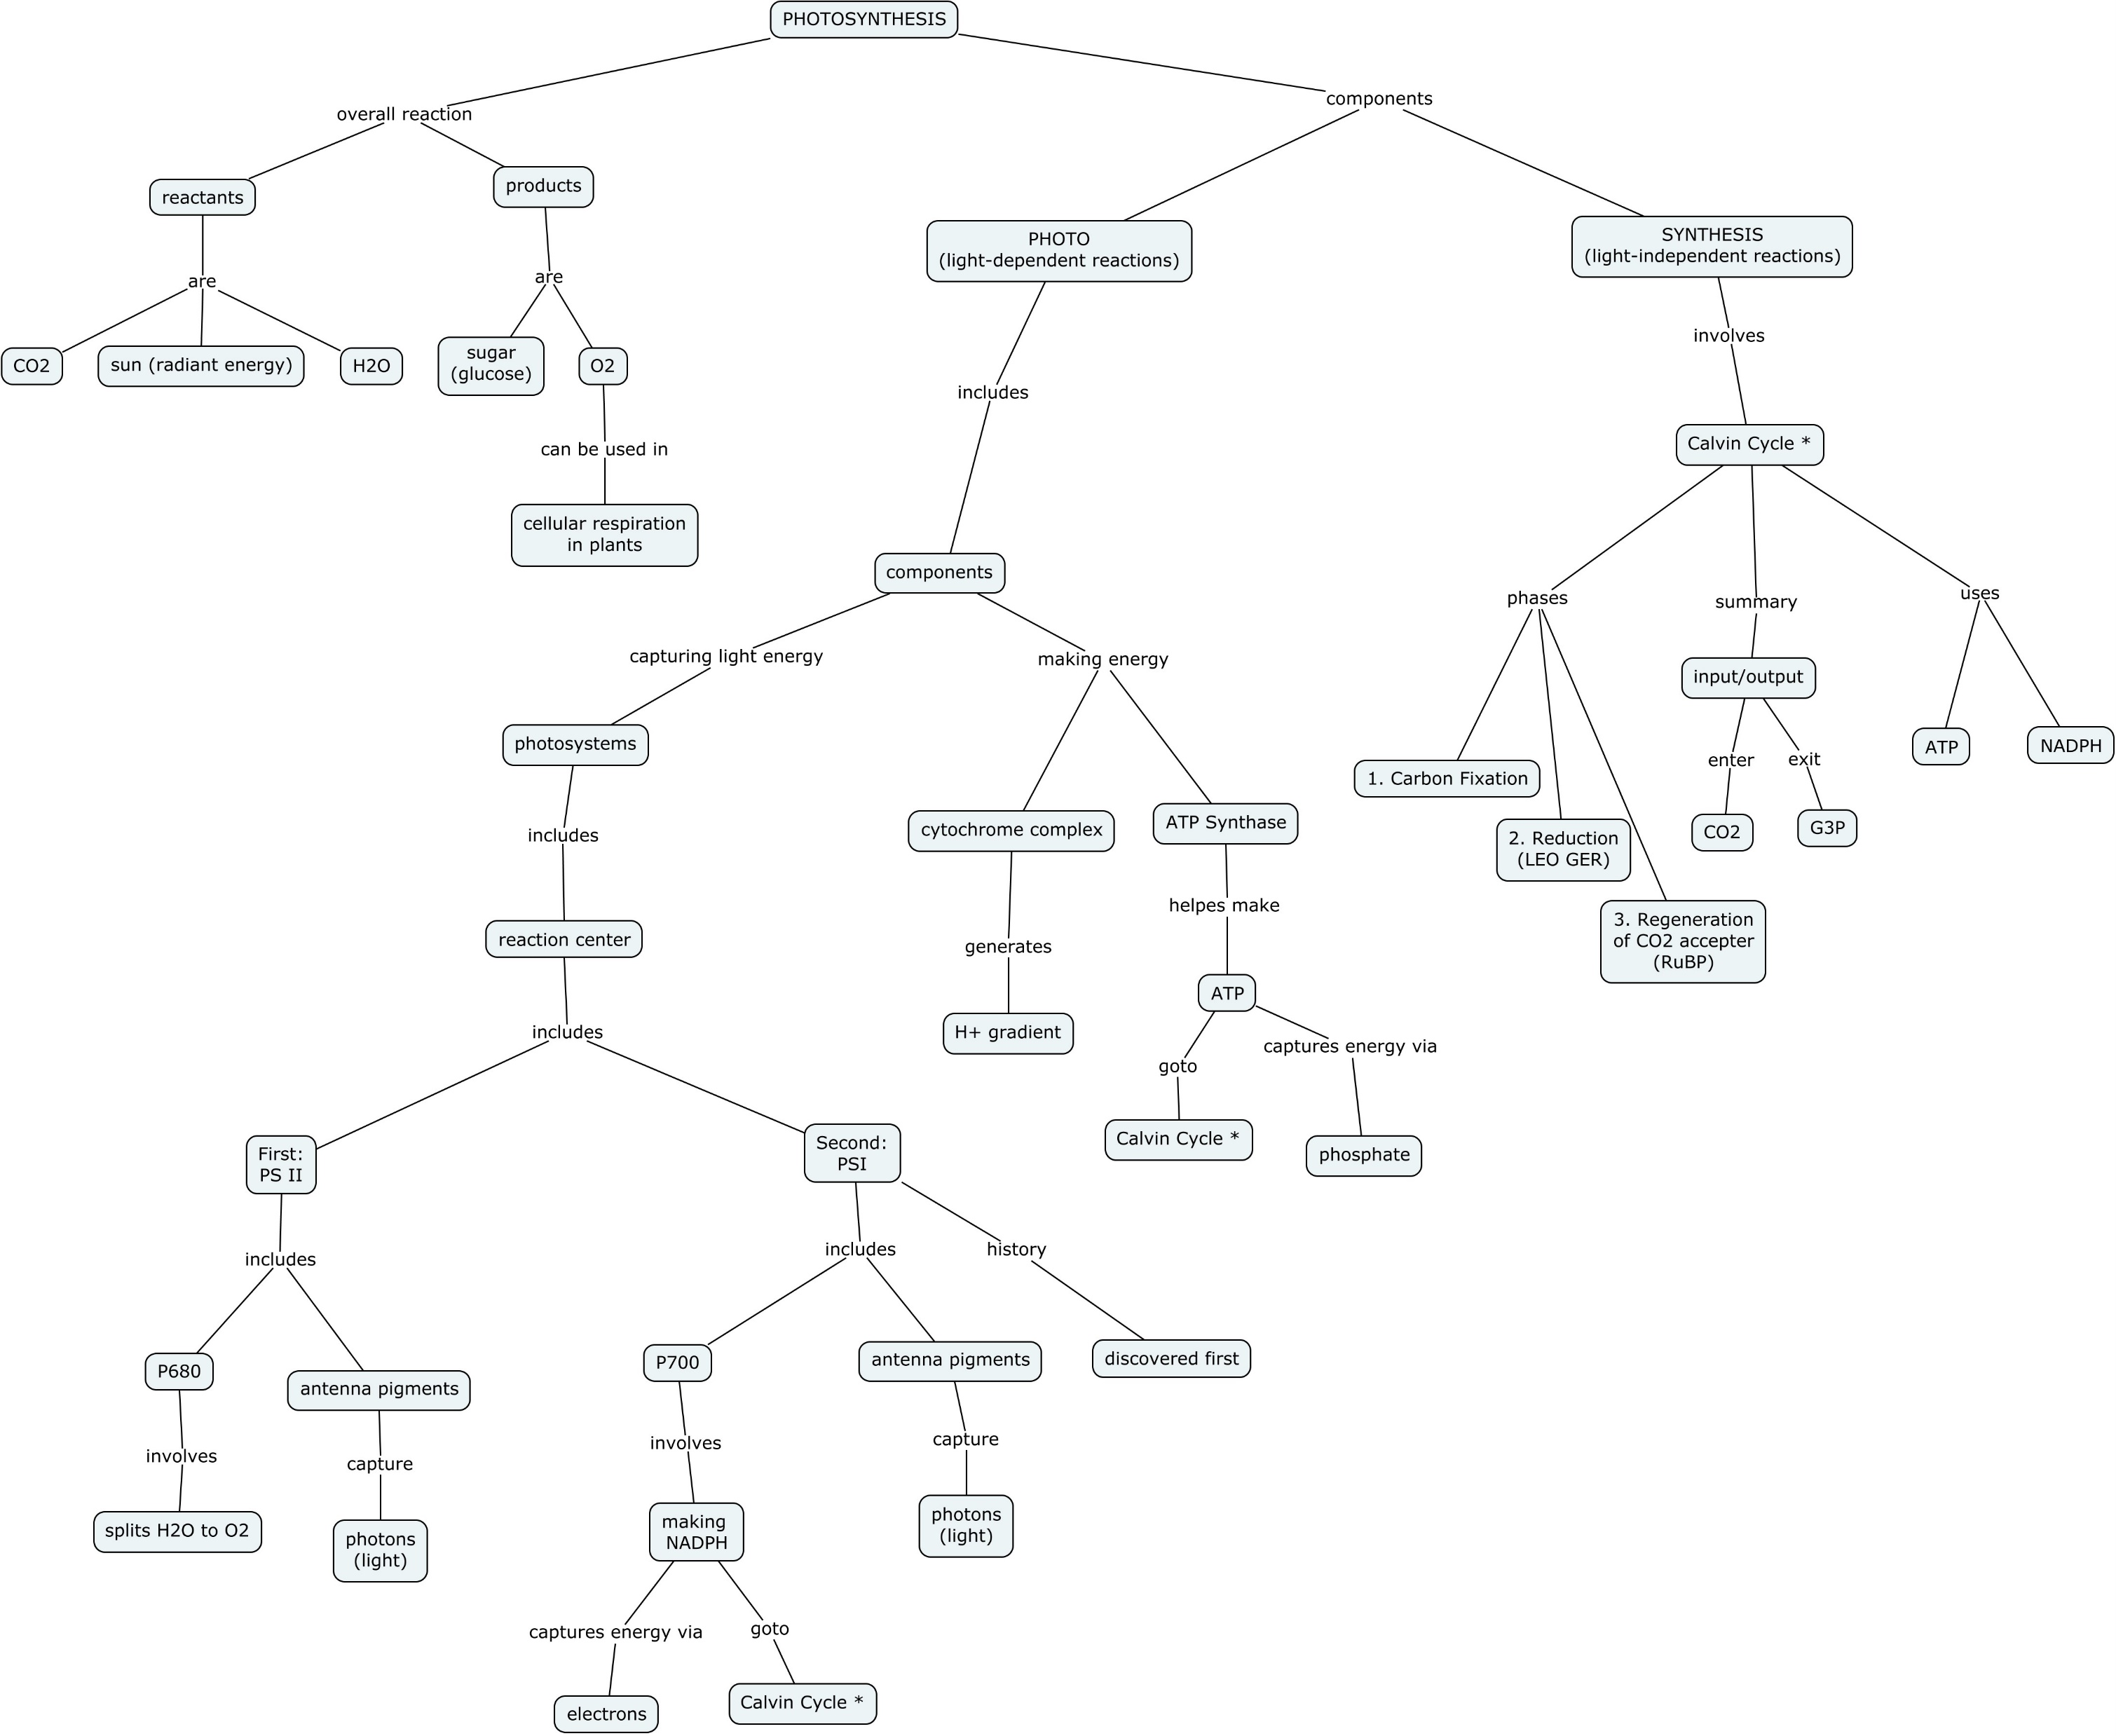
Method 4: Showcase building a concept map during lecture (all while encouraging real-time feedback!) and then as a “gift,” provide the map to the class!
EXAMPLE 1: Photosynthesis

Slide 39
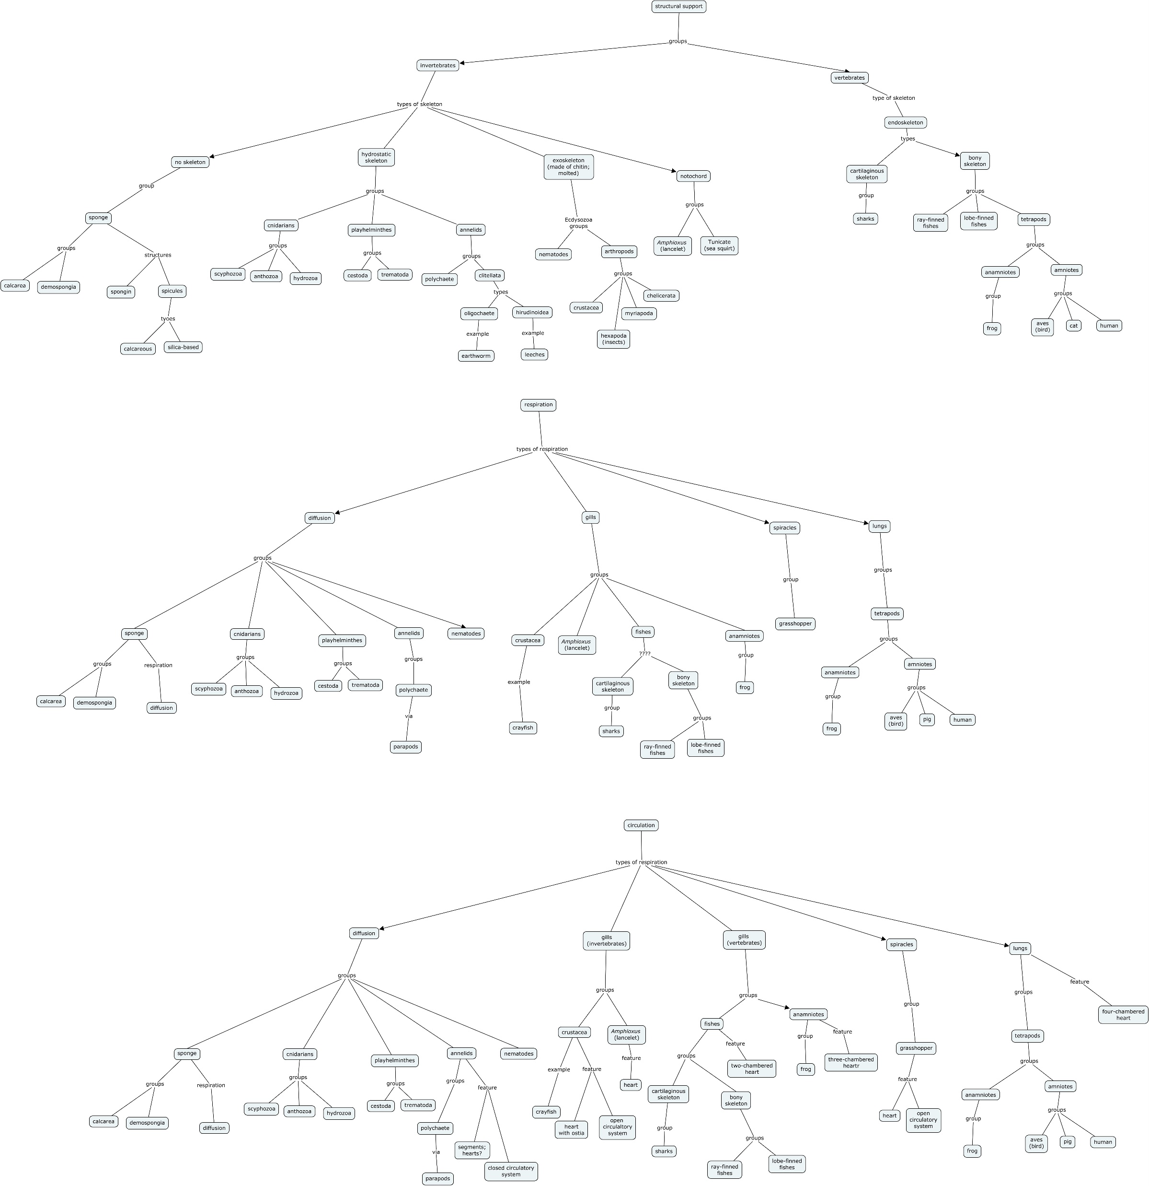
EXAMPLE 2: Organismal Diversity

Slide 40
Method 5

Slide 41
Method 5: Concept maps can be used for formative assessment and summative assessment.
See Soika et al. 2012!

Slide 42
Outline
What is Concept Mapping?
What is a Concept Map?
Literature Review
Pros and Cons of Concept Maps
Classroom Implementation of Concept Maps
Introduction to CMAPS software
Case Studies in Introductory Biology
Case Studies in Anatomy and Physiology

Slide 43

Switch to Emma!

Slide 44

Workshop Wrap-Up

Slide 45
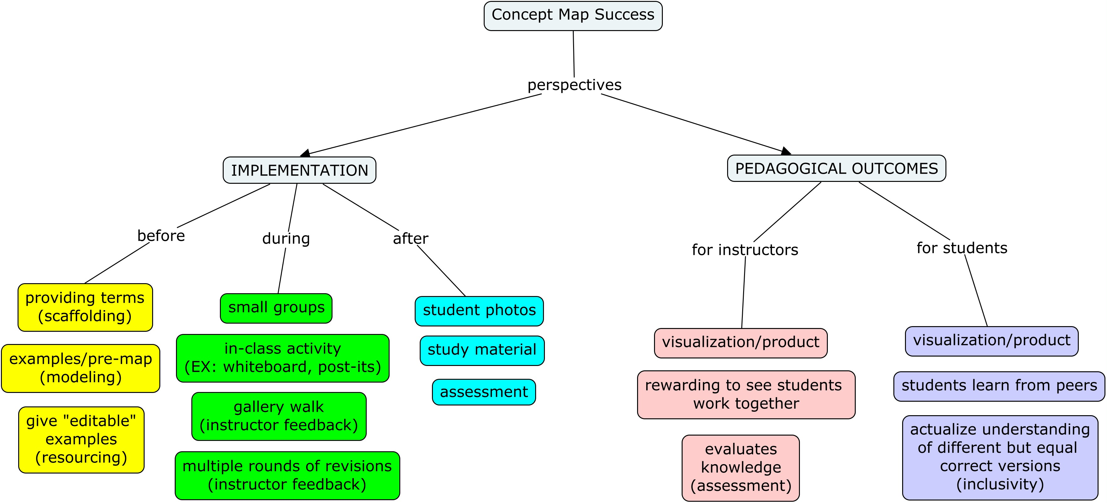

Slide 46
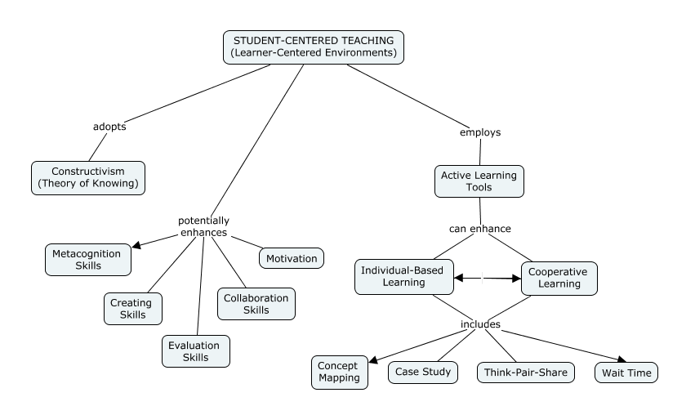

Slide 47

Acknowledgements

